Slide 1

October 10, 2018
Wifi: 1393Conference
Password: kayla1393

Slide 2

BusinessLIHC Bingo
Nassau Event held at Hofstra University
Next Event:
Thursday, November 8
9:30am-11:30am
Riverhead Free Library
Riverhead, NY
suffolkbingo.eventbrite.com
www.lihealthcollab.org

Slide 3

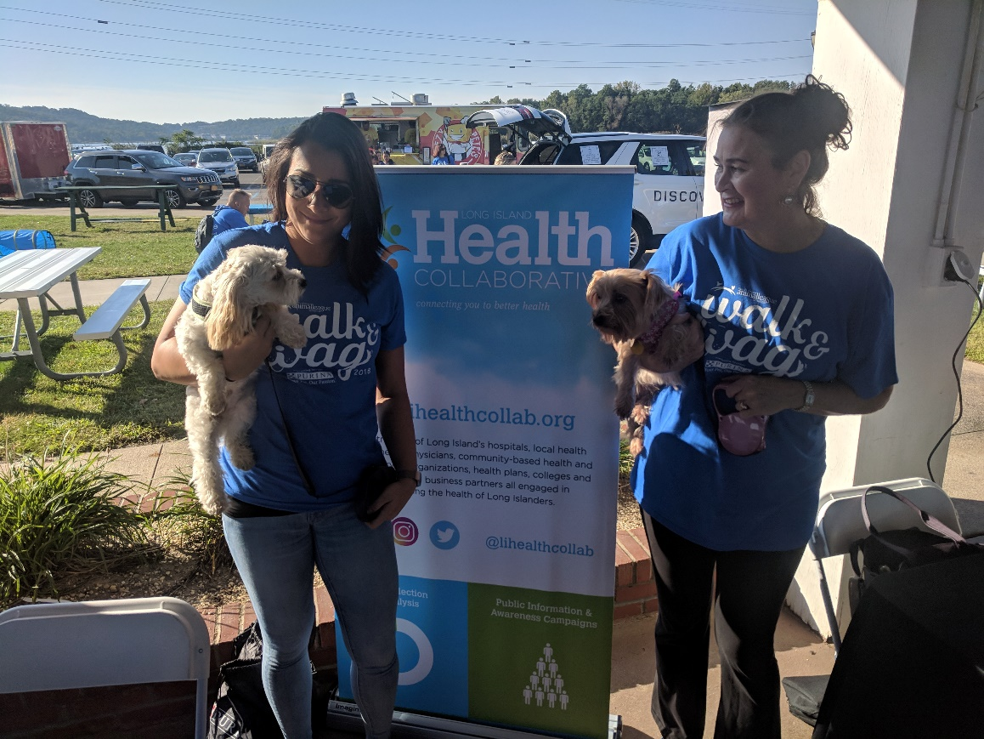
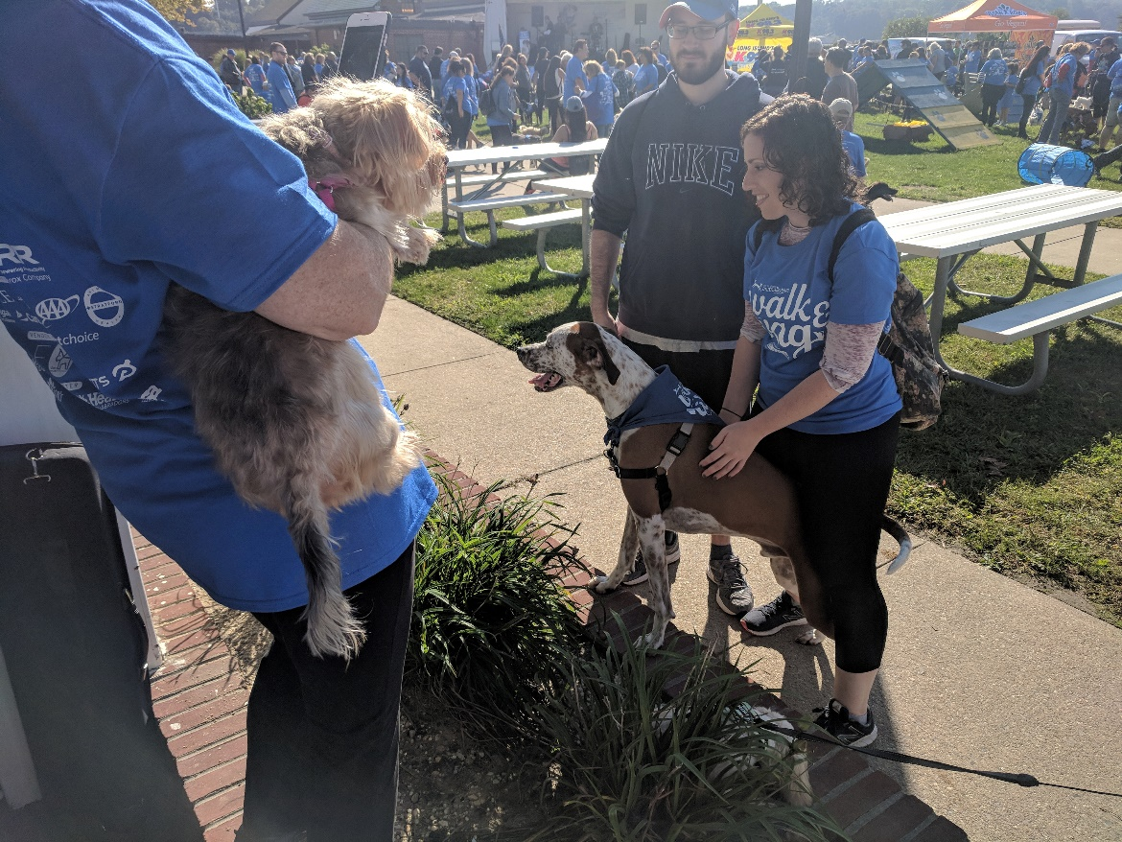
Walk & Wag
with North Shore Animal League America
www.lihealthcollab.org

Slide 4
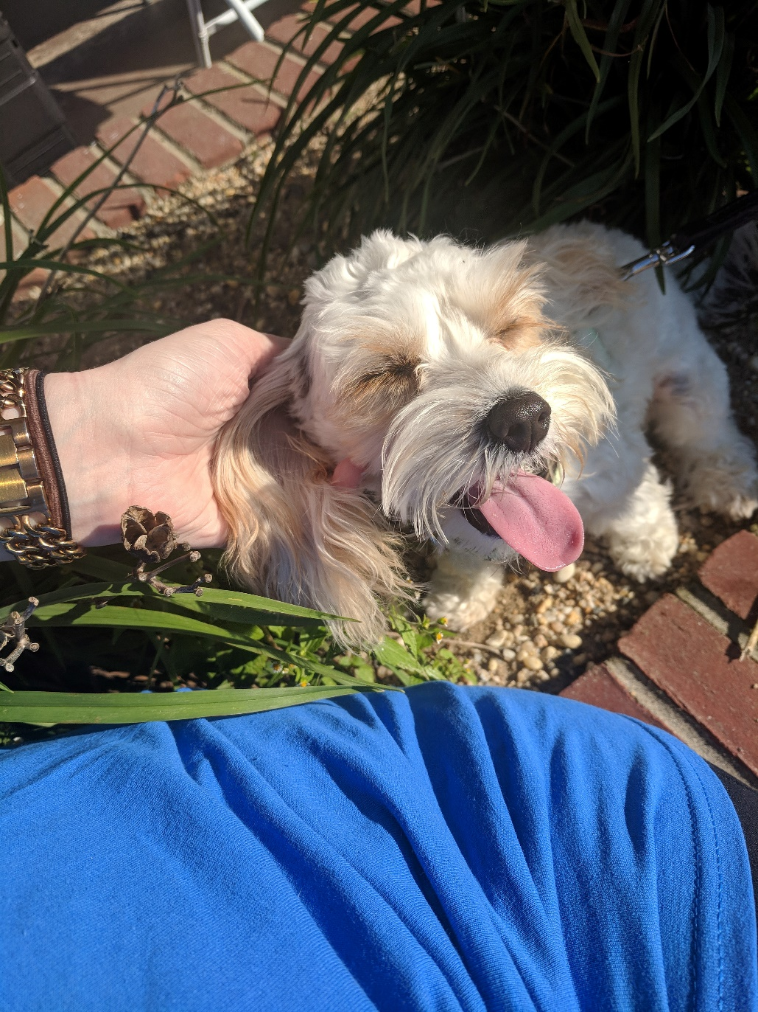
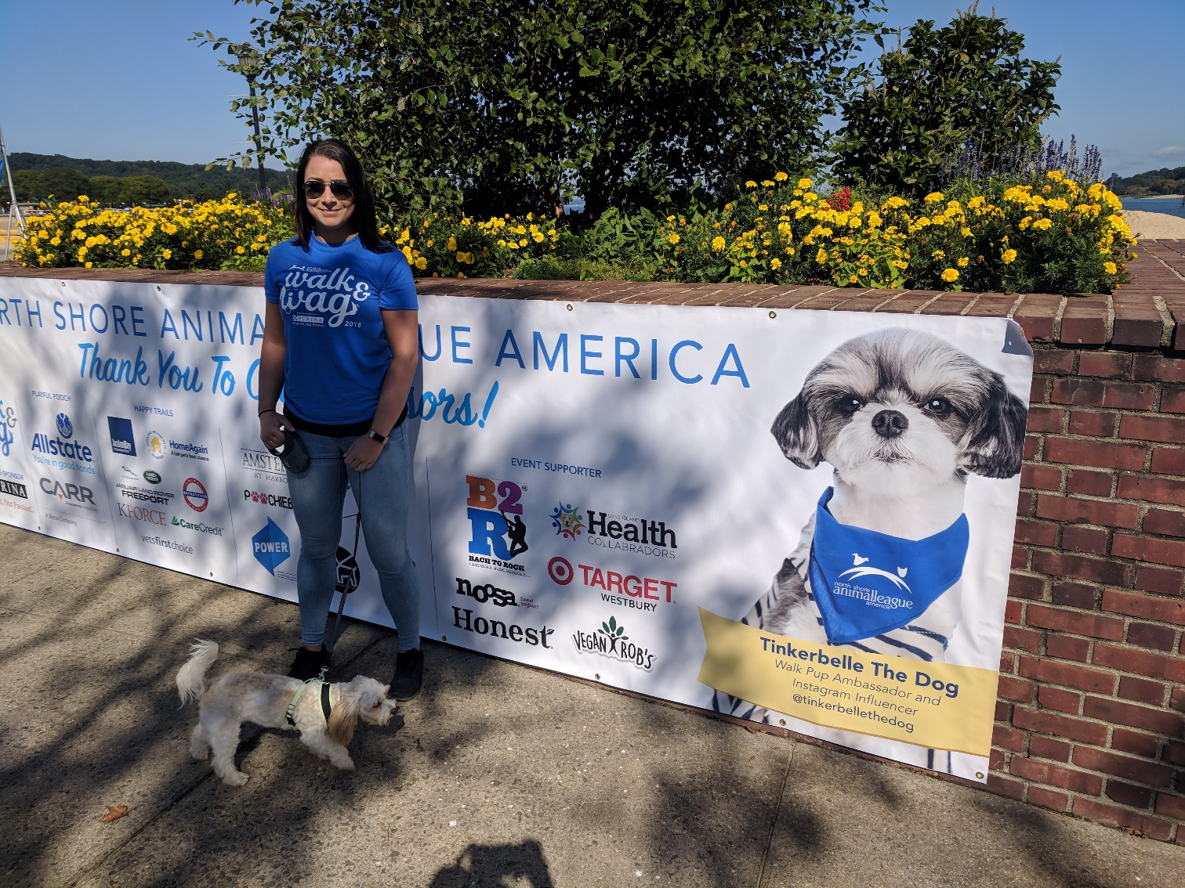
www.lihealthcollab.org

Slide 5
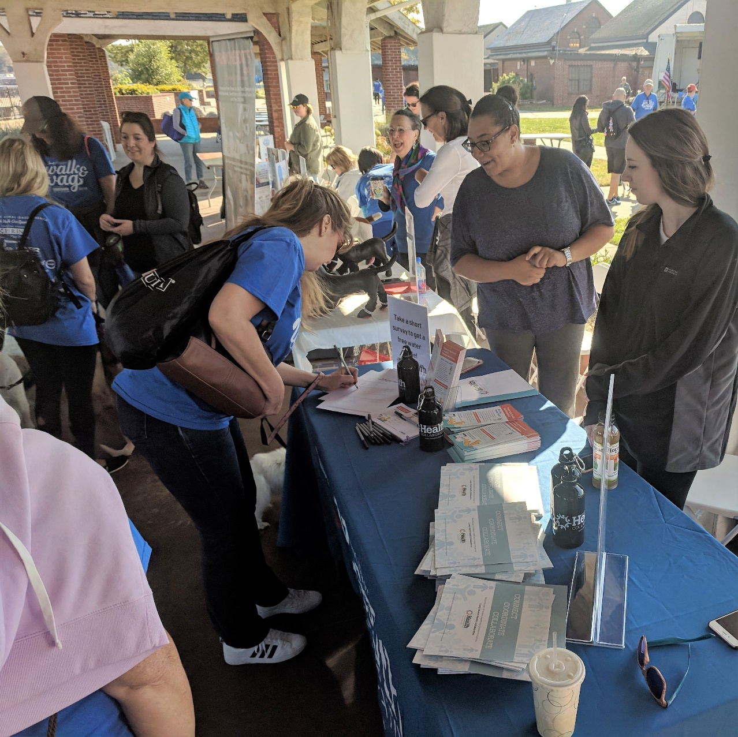
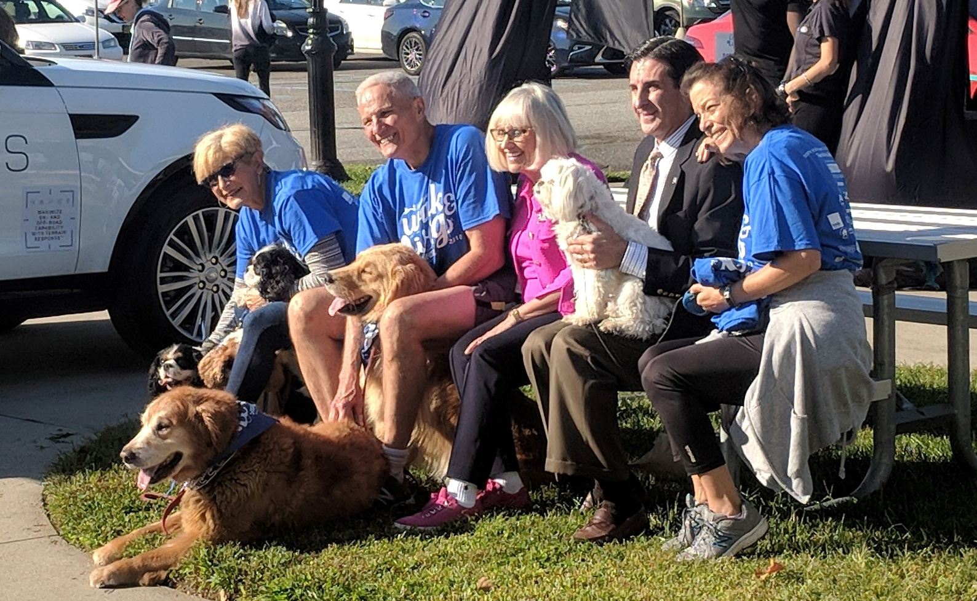

Slide 6
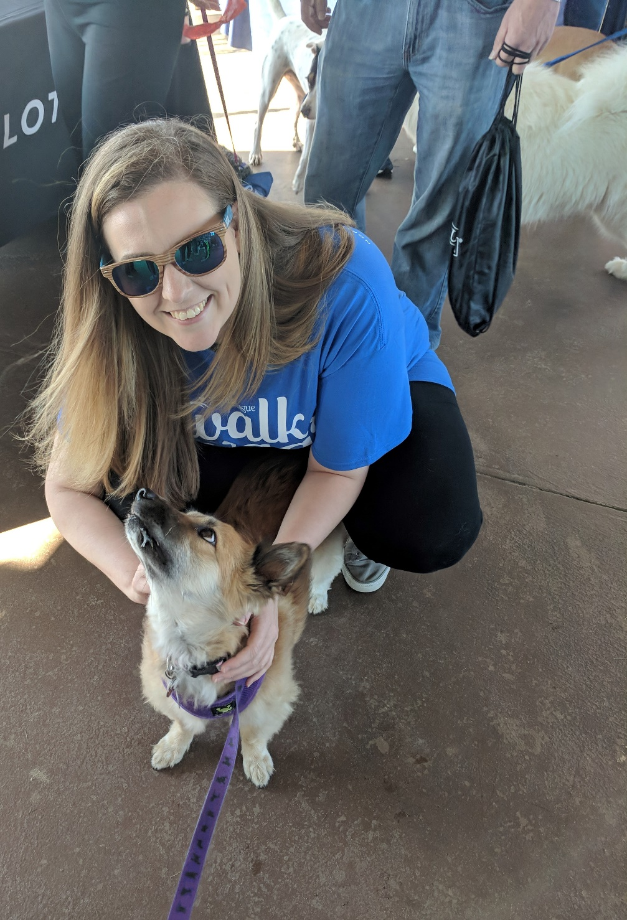
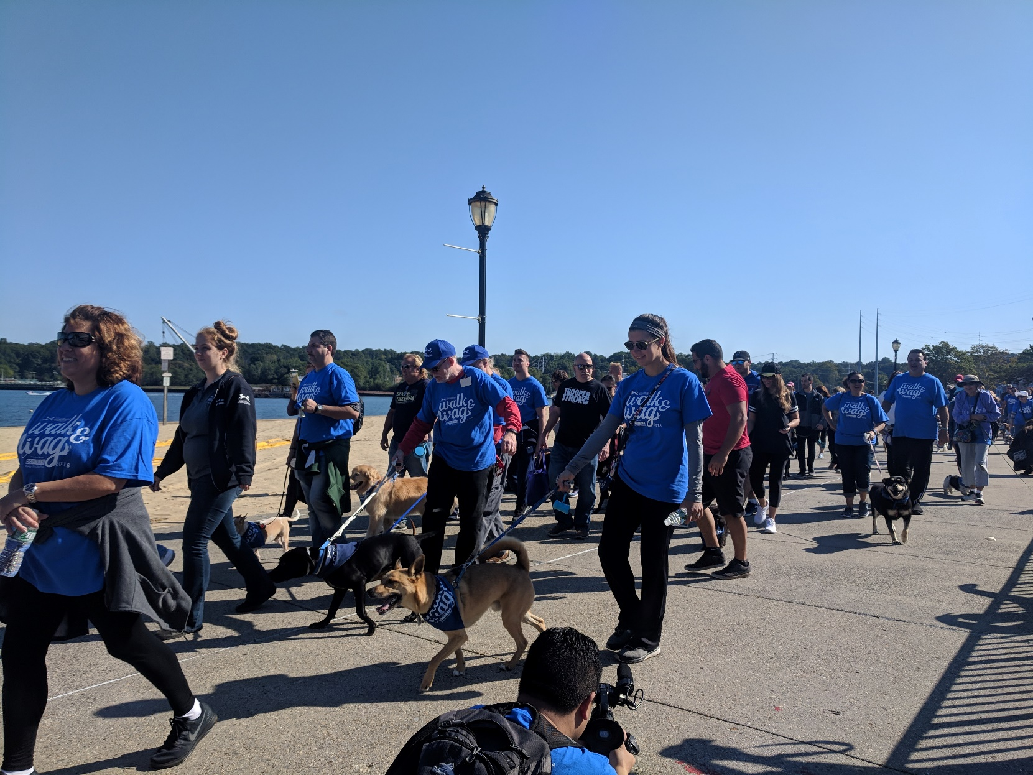

Slide 7
Food Access Cluster
Members:
Northwell Health
Island Harvest
Eat Smart NY
Western Suffolk BOCES Creating Healthy Schools and Communities Grant
Cohen’s Children Medical Center Breast Feeding Grant (BFREE)
Kohl’s Cares Keeping Kids Healthy Grant
LI Cares
www.lihealthcollab.org

Slide 8
Food Access and the Prevention Agenda
Focus Area 1: Healthy Eating and Food Security
Overarching Goal: Reduce obesity in children and adults
Goal 1: Increase access to healthy and affordable foods and beverages
Goal 2: Increase skills and knowledge to support healthy food and beverage choices
Goal 3: Increase food security
www.lihealthcollab.org

Slide 9
Food Access and the Prevention Agenda
Focus Area 1: Intermediate Goals/Measures
Goals:
Food Security
By December 31, 2024, increase the percentage of adults with perceived food security
Fruit and Vegetable Purchasing
By December 31, 2024, increase the percentage adults who buy fresh fruits and vegetables in their neighborhood
Adult Obesity
By December 31, 2024, decrease the percentage of adults ages 18 years and older who are obese
Measures:
Percent of eligible New Yorkers participating in SNAP
Percent of eligible New Yorkers participating in WIC
Number of schools that improve nutrition policies and practices (WellSAT 2.0)
www.lihealthcollab.org

Slide 10
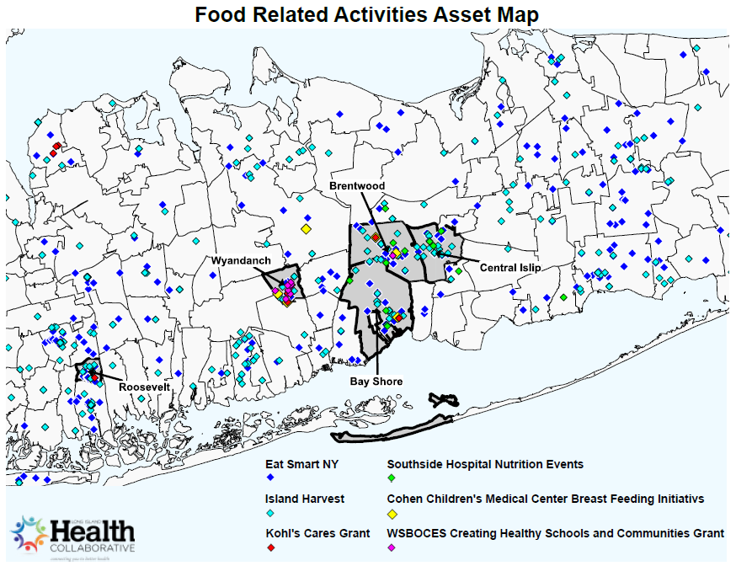

Slide 11
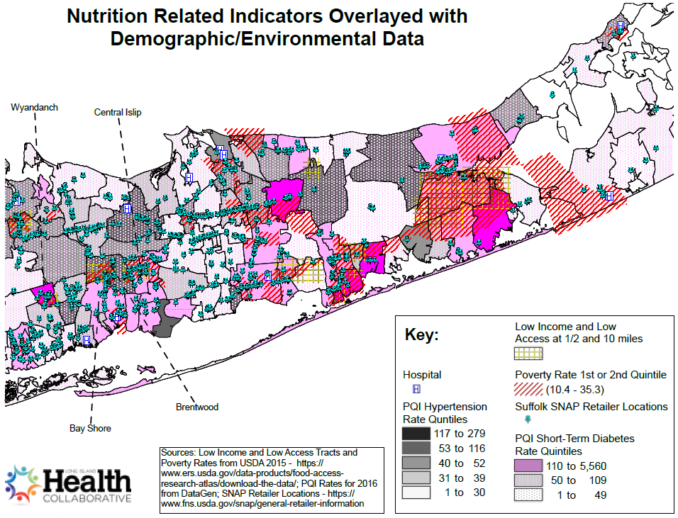

Slide 12
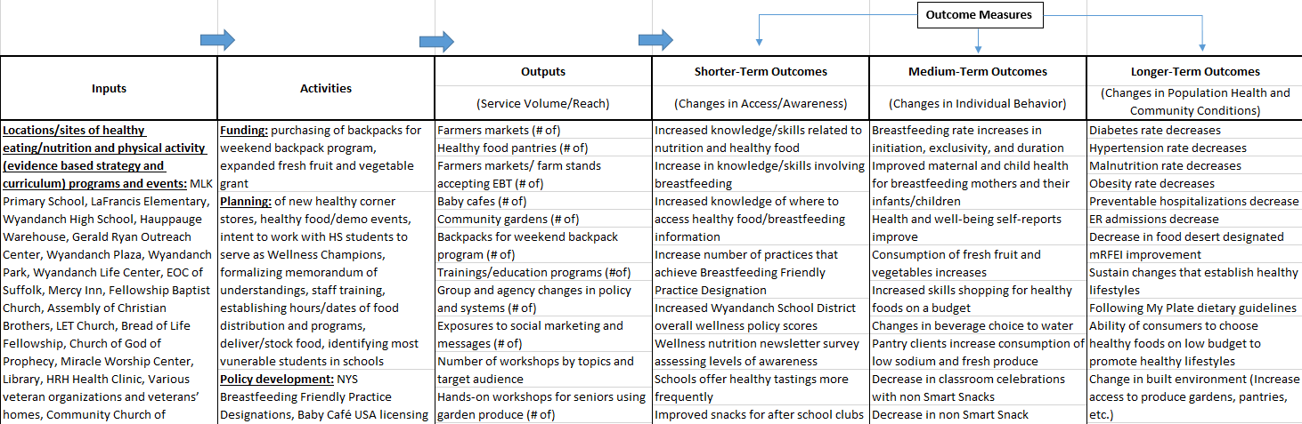

Slide 13
Metrics
Shorter-Term Outcomes
Increased WIC check redemption rates
  The Farmers' Market Nutrition Program provides Wyandanch number of WIC checks issued, redeemed, and the redemption rate
Medium-Term Outcomes
Decrease in classroom celebrations with non Smart Snacks
  Wyandanch school district’s WellSAT 2.0 score for “Regulates food served during classroom parties and celebrations in elementary schools”
Longer-Term Outcomes
Malnutrition rate and obesity rate
  SPARCS, ICD10 E40-E46 and ICD10 E65-E68
www.lihealthcollab.org

Slide 14
New York State Prevention Agenda Update
New York is the Healthiest State for People of All Ages
www.lihealthcollab.org

Slide 15
Cross-Cutting Principles
To improve the health outcomes, enable well-being and promote equity across the lifespan the Prevention Agenda will:
Focus on social determinants of health and health disparities
Incorporate a health in all policies approach
Emphasize health aging across the lifespan
Support inclusive community engagement and collaboration across sectors in the development and implementation of local plans
Maximize impact with evidence based interventions for state and local action
Advocate for increased investments in prevention from all sources
Concentrate on primary and secondary prevention, not on healthcare design or reimbursement
www.lihealthcollab.org

Slide 16
Prevention Agenda Priorities
2019-2024
Prevent Chronic Diseases
Promote a Healthy and Safe Environment
Promote Healthy Women, Infants and Children
Promote Well-being and Prevent Mental and Substance Use Disorders
Prevent Communicable Diseases
www.lihealthcollab.org

Slide 17
Five Draft Priority Specific Action Plans
Focus Areas and Goals
Measureable Objective(s) including those that measure disparities
2-5 Evidence Based Interventions for state and local action
Include resources for implementation
For each evidence based intervention, plan:
Identifies specific age groups that will be reached, with special attention to older adults
Identifies social determinants and health disparities being addressed
Identifies roles different organizations and agencies can play
Identifies intermediate level measures to track progress
www.lihealthcollab.org

Slide 18

Networking & Stretch Break
www.lihealthcollab.org

Slide 19
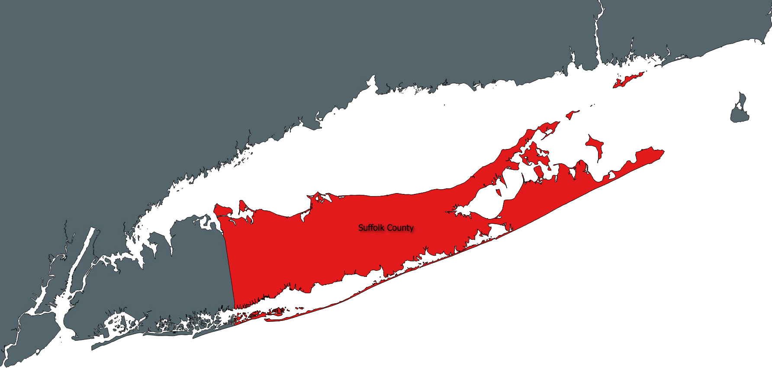
Suffolk Care Collaborative Announcements
Community Engagement Team
Stephanie Burke, MS, MHA, CHES
Administrative Manager, Community Engagement & Cultural Competency
Suffolk Care Collaborative

Slide 20
Innovative Trends in
Community Partnerships
Featured Panel Discussion
Moderated by
Denard Cummings, Director, Bureau of Social Determinants of Health, NYSDOH
Panelists
Dr. Susan Beane, VP, Medical Director, Clinical Partnerships, Healthfirst
Dr. Ram Raju, Sr. VP and Community Health Investment Officer, Northwell Health
Dorella Walters, Sr. Director of External Program Affairs, God's Love We Deliver
Date: | Tomorrow, October 11th
Time: | 8:30 am – 11:00 am
Location: | Old First Presbyterian Church 125 Main Street – Parish Hall Huntington, NY
To register please contact: | CommunityEngagement@StonyBrookMedicine.edu

Slide 21
New Data Developments
Quarterly Thematic Reports
  Q1: Physical Activity In Adults- A Look Into the Long Island Region
  Q2: Dietary Habits In The Region: The Prevalence of Diabetes and Hypertension on LI and Their Correlation With Nutrition/Eating Habits
  Q3/Q4: Take our survey and let us know!
CHAS Survey Results
www.lihealthcollab.org

Slide 22
New Data Developments
New Website Data Components:
  Data Request Form – Streamlining data & analysis requests from our members to our team
  Data Assistant – A new system for organizing the data made available to our members and the public, via the LIPHIP.
www.lihealthcollab.org

Slide 23
Feedback + Adjournment
Last meeting of the year is December 13!
To register, visit
LIHCdec2018.eventbrite.com
www.lihealthcollab.org

